Slide 1
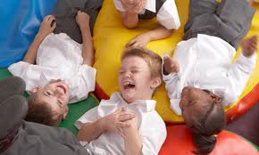

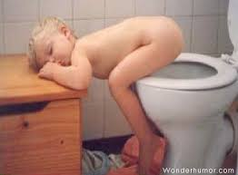

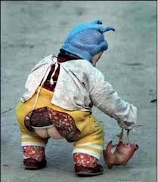
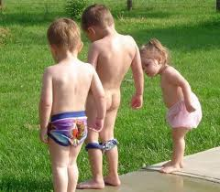
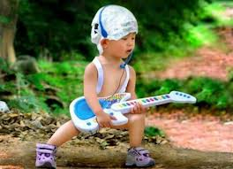
Paediatric Emergency Nursing

Slide 2
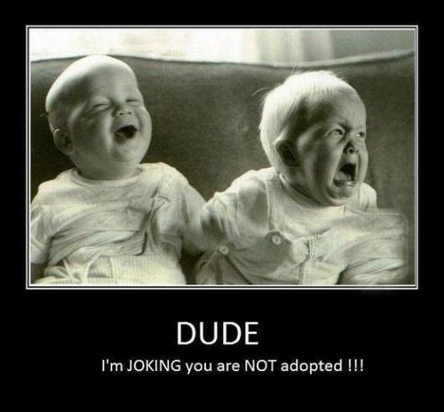

Slide 3

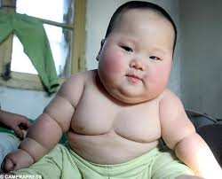
Paediatric Emergency
What children present to the ED?
Paeds def’n: <18 years of age
~5% of TEMS calls are for children
~8% of visits to UH are paediatrics
Most critical kids < 6yrs and present with resp. or neuro emergencies.
Resp. illness accounts for 38% admissions in kids < 15 yrs.
Notes:
Most critically ill children are younger than 6 years of age and present with respiratory or central nervous system emergencies. Respiratory system illnesses account for 38% of the admissions of children under 15 years of age.

Slide 4
Causes of Pediatric Death
Neonates: Birth-related conditions & congenital
anomalies are leading causes
Infants: SIDS is leading cause of death in infants
from 30 days – 1 yr.
Children > 1 yr.: Injury & Trauma is leading cause
of death

Slide 5
What is UNIQUE about Children?
Immature respiratory and cardiovascular systems
Higher metabolic rate (growing)
Higher fluid and caloric intake/kg
Anatomy and physiology is different
Illnesses are different; so is their response to illness
Developmental differences affect how you approach the child as well as treatment choices

Slide 6
What is Unique About Kids?
Larger BSA- Children have a proportionately larger body surface area (BSA) than adults do.
Rapidly dividing cells- Children's cells divide more rapidly than adults
Higher HR and RR- Children have higher respiratory rates than adults. Higher respirator rates lead to proportionately higher minute volumes.
Notes:
BSA--Children have a proportionately larger body surface area (BSA) than adults do. Rapidly dividing cells- Children's cells divide more rapidly than adults to assist in their rapid rate of growth The smaller the patient, the greater the ratio of surface area (skin) to size. As a result, children are at greater risk of excessive loss of heat and fluids; children are affected by more quickly and easily toxins that are absorbed through the skin.
Rapid cell growth- to assist in their rapid rate of growth As a result, children are more susceptible to the effects of radiation than adults.
Rapid RR & HR- As a result, children may be more susceptible to agents absorbed through the pulmonary route than adults with the same exposure
Higher metabolic rate- Medication doses must be carefully calculated based on the child's weight and body size

Slide 7
What is Unique About Kids?
Immature blood brain barrier- Children have immature blood-brain barriers and enhanced central nervous system (CNS) receptivity
Higher metabolic rate- More susceptible to toxins and contaminants in food/water; greater risk for increased loss of water (dehydration) when ill or stressed.
Immature immune systems- Greater risk of infection
Notes:
blood–brain barrier allows the passage of water, some gases, and lipid soluble molecules by passive diffusion, as well as glucose and amino acids. On the other hand, the blood–brain barrier may prevent the entry of lipophilic, potential neurotoxins. With immaturity, kids are more susceptible to neurotoxicity.

Slide 8

An Initial, Critical Look
Subtle onset of symptoms: trends, observations
listen to parents
Pediatric Assessment Triangle
Compensation vs Decompensation
Resuscitation
Notes:
only 5% kids have life threatening condition

Slide 9



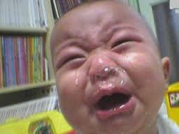
Sleeping babies are unconscious
babies;
Wake them up!

Slide 10
Primary Assessment
A - Airway
B - Breathing
C - Circulation
D – Disability / Neuro
E - Exposure

Slide 11

Vital signs in Children
Tachycardia is early response to stress
BP changes are often an ominous sign
Bradycardia can be an ominous sign
Pulse Oximetry is less reliable
Capillary refill is important
Don’t forget temperature

Slide 12
Respiratory & Heart Rate
Age
Respiratory Rate
Normal Range
Heart Rate
Normal Range
Birth – 3 months
30 - 60
90 - 180
3 – 6 months
30 - 60
80 - 160
6 months –1year
25 - 45
80 - 140
1 – 3 years
20 - 30
75 - 130
3 – 6 years
16 - 24
70 - 110
6 – 10 years
14 - 20
60 - 90
10 – 17 years
12 – 16
55 – 85

Slide 13
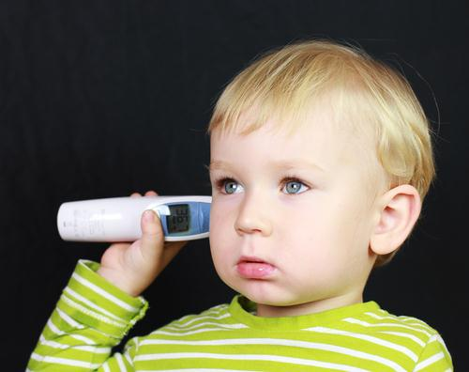
Temperature
FEBRILE VALUES:
Temp> 38C rect (2-6mos)
Temp> 38C tymp/ax/rect (6-12mos)
Temp>38.5 tymp/ax/rect (>12mos)

Slide 14
Acquiring Temperature
Age
Recommended technique
Birth to 2 years
1st choice: 2nd choice:
Rectum (for an accurate reading) Armpit
Between 2 and 5 years
1st choice: 2nd choice:
Rectum (for an accurate reading) Ear, armpit
Older than 5 years
1st choice: 2nd choice:
Mouth (for an accurate reading) Ear, armpit
Rectal temp. controversial in pts. <28 days
and in those who are immunocompromised
Notes:
The right method depends on your child’s age. It’s important that the measurement is accurate. For instance, taking a rectal temperature is still the best way to get an exact reading for children under 2 years of age. Although taking a temperature under the armpit isn't as reliable, it may let you know whether your child has a fever. Temporal artery devices for home use have not yet been shown to be accurate or reliable enough.
Temperature measurement in paediatrics

Slide 15
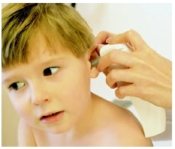
Tympanic Route
Measures the thermal radiation emitted from the tympanic membrane
Crying, earwax and otitis have not been shown to influence readings
Contraindicated in presence of drainage, blood, or complete cerumen (ear wax) blockage.

Slide 16
Capillary Refill
Should be < 2 seconds
Reflection of skin perfusion
Early indicator of abnormalities in cardiac output
Lift extremity slightly above heart level…ensures arteriolar cap refill
Notes:
Causes of sluggish or delayed cap refill: dehydration, shock, hypothermia
Warm septic shock often cap refill very quick
To evaluate capillary refill, elevate the extremity above the level of the heart to ensure that arterial (not venous) perfusion is being evaluated.
Note: Capillary refill can also be prolonged in cold ambient temperatures or hypothermia.

Slide 17
BP Values
As the child grows, the size of the left ventricle increases, resulting in increased BP values
Age Minimum sys BP
0 to 1 month 60 mm Hg
>1 month to 1 year 70 mm Hg
1-10 yrs 70 + 2x age (in yrs.)
> 10 yrs 90 mm Hg

Slide 18
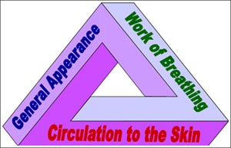
Assessment Tools:
Paediatric Assessment Triangle
Critical look

Slide 19
PAT: General Appearance
T: Tone
I: Interactability
C: Consolability
L: Look/gaze (ability to focus)
S: Speech/cry

Slide 20
PAT: Work of Breathing
Count Resp. rate
Observe: Flaring, Tug, Desired Position,
Retractions,
Listen: Breath sounds, Stridor, Wheezing,
Grunting,
Parents’ concerns

Slide 21

PAT: Circulation to the Skin
Skin colour
Bleeding?
Capillary Refill
Signs of dehydration: Fontanelles, Sunken eyes,
Mucous membranes

Slide 22
Baseline Assessments
Document baseline assessments in detail
Use age-based physiologic scales
Subtle increases in HR and RR are significant
especially in the absence of stimuli

Slide 23
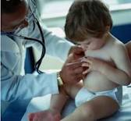
Approaching the Child
Consider developmental age
Calm parents first, if anxious
Use non-threatening, honest approach
Consider what child has been taught:
“Never talk to strangers”
Fear of the unknown
Consider previous healthcare experiences
Begin with least invasive
“A child’s illness is a family crisis”

Slide 24
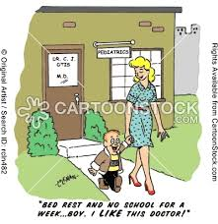
Respiratory Assessment
of the pediatric ED patient

Slide 25


Slide 26
Respiratory System: How Children are Different from Adults
Bigger tongue
Larger heads
Diaphragm and abd. muscles are main resp.
muscles (compared to chest)
Floppy epiglottis
Narrower airway
Padlipsky & Gausche-Hill, 2008

Slide 27
Respiratory System: How Children Differ from Adults
Inability to express concerns
Nose breathers (infants)
Fewer alveoli
Can maintain normal SpO2 for <1/2 time of adult after apneic event

Slide 28

Developmental Transition
By approx. age of 8, child’s respiratory system
is proportionately similar to an adult’s
Padlipsky & Gausche-Hill, 2008
Notes:
Think CPR etc

Slide 29
Respiratory Assessment
Inspection: Undress, Resp. rate, Rhythm, Quality,
Effort;
Look for Retractions, Tug, Flaring, Desired position,
Restlessness, Anxiety, Focus, Interactions
Listen: To patient & parents’ concerns,
Breath sounds, Stridor, Wheezing, Grunting,
Cough

Slide 30
Respiratory Distress & Failure
Respiratory Distress Respiratory Failure
Airway: | Maintainable Not maintainable
Breathing | Tachypnea Bradypnea to apnea
Work Of Breathing | Effort Effort Apnea
 | Good air movement Poor to absent movement
Circulation | Tachycardia Bradycardia
 | Pallor Cyanosis
Disability | Anxiety, agitation Lethargy to unresponsive
Exposure | Variable Temperature
AHA, 2011
Notes:
Respiratory distress: a child’s response to inadequate gas exchange in the lungs resulting from any condition that compromises oxygenation and ventilation. Signs include: increased respiratory rate, increased work of breathing, retractions, use of accessory muscles, including nasal flaring, and breathing may be noisy (grunting, wheezing, stridor)
Respiratory failure occurs when a child is no longer able to compensate sufficiently and inadequate oxygenation and ventilation result in hypoxia. Signs include an abnormal appearance (agitation initially, lethargy and decreased conscious level, pallor and cyanosis as failure progresses). Respiratory rate and work of breathing are increased at first but decrease as the child’s condition becomes more severe, often associated with the ominous sign of bradycardia.
Careful assessment and intervention in cases of actual or impending respiratory failure can prevent the progression to respiratory arrest in many situations.

Slide 31
General Management of Upper Airway Obstruction
Allow pt. to assume position of comfort
Jaw thrust or head tilt/chin lift
Foreign body removal
Suction mouth or nose
AHA, 2011

Slide 32
General Management of Upper Airway Obstruction
Reducing airway swelling with meds
Minimizing anxiety
Consider airway adjunct or intubation
Consider whether tracheostomy is needed

Slide 33
Management of Specific Respiratory Emergencies Flowchart (AHA)
Upper Airway Obstruction
Croup | Anaphylaxis | Aspiration Foreign Body
Nebulized epinephrine Corticosteroids | IM Epinephrine Salbutamol Antihistamines Corticosteroids | Allow position of comfort Specialty Consultation
American Heart Association, (2011)
Notes:
Croup: An infection of the larynx, trachea, and bronchial tubes that occurs mainly in children. It is usually caused by viruses but sometimes by bacteria
What sounds are typically heard with upper airway obstruction? Inspiratory because an obstruction here means that limited air is getting thru

Slide 34
Management of Specific Respiratory Emergencies Flowchart (AHA)
Lower Airway Obstruction
Bronchiolitis | Asthma
Nasal suctioning Bronchodilator trial | Salbutamol +/- Ipratropium Corticosteroids Subcutaneous Epinephrine Magnesium Sulfate Terbutaline
American Heart Association, 2011
Notes:
Expiratory sounds – lower obstruction – air can’t get out
Bronchiolitis usually affects children under the age of 2, with a peak age of 3 to 6 months. It is a common, and sometimes severe illness. Respiratory syncytial virus (RSV) is the most common cause. More than half of all infants are exposed to this virus by their first birthday.

Slide 35
Management of Specific Respiratory Emergencies Flowchart (AHA)
Disordered Control of Breathing
Increased ICP | Poisoning/OD | Neuromuscular Disease
Avoid hypoxemia Avoid hypercarbia Avoid hyperthermia | Antidote (if optional) Contact poison control centre | Consider noninvasive or invasive ventilatory support
American Heart Association, 2011

Slide 36
Management of Specific Respiratory Emergencies Flowchart (AHA)
Lung Tissue Disease
Pneumonia/ Pneumonitis Infectious/Chemical/ Aspiration | Pulmonary Edema: Cardiogenic or Non-cardiogenic (ARDS)
Salbutamol Antibiotics (as indicated) | Consider ventilatory support Consider vasoactive support Consider diuretic
American Heart Association, 2011

Slide 37

Nursing Care
A, B, C
airway management; suction prn; oxygen
Watch patients closely
Look for trends and subtle changes

Slide 38
Cardiac Arrest
Uncommon with poor prognosis;
Usually of respiratory origin
Quality CPR!
Push hard
Push fast
Allow for adequate chest recoil
15:2 for health care providers!!!
Neonates: 3:1

Slide 39
Cardiac Arrest
For pediatric patients with HR< 60
with poor perfusion despite
Oxygenation & ventilation,
compressions are initiated.
Age group: all pre-pubescent children
often used as guideline
Steinmann, 2014

Slide 40
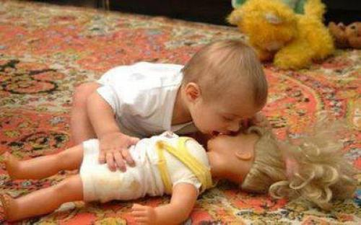

Slide 41
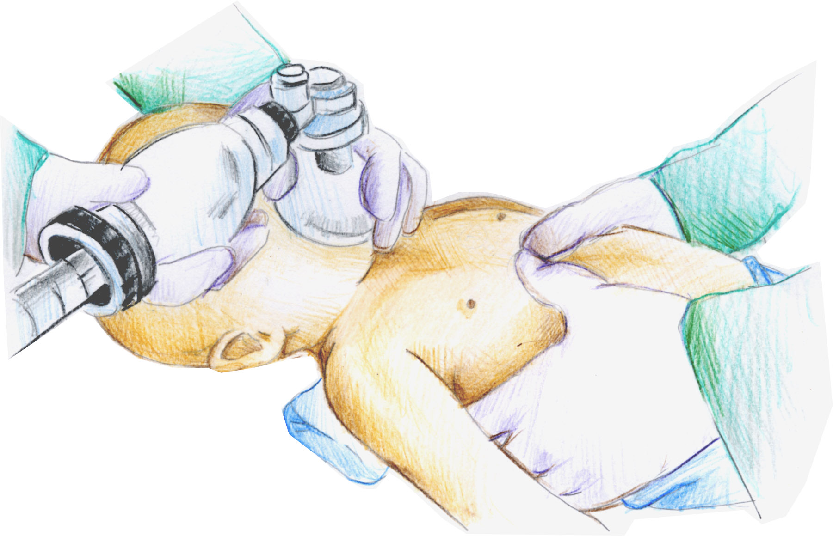
CPR: Infant technique

Slide 42
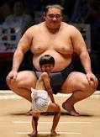
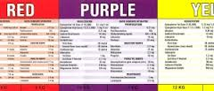
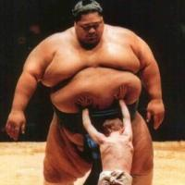
Does size matter?
When determining size of
equipment required for a pediatric patient
consider the Broselow tape
Pt.’s length determines
colour category

Slide 43
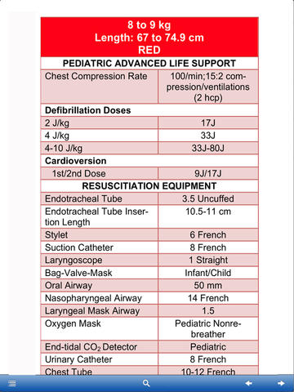
Broselow Tape
Indicates size
equipment
required
Found in resus. room
at UH

Slide 44

Cardiovascular Assessment
of the pediatric patient

Slide 45
Cardiac Assessment
Capillary Refill – considered a pediatric vital sign
Pulses – compare peripheral to central
Central: Carotid if >1yr; Brachial/femoral if
<1yr
Skin Color - measures skin perfusion
Notes:
Central stronger than peripheral...
Exaggerated difference occurs with significant vasoconstriction often associated with shock
Weakening of central pulses is an ominous sign!

Slide 46
Cardiac Assessment
Fluid status – mucous membranes, fontanelles
Heart Rate, Rhythm - rapid: stress, fever, dry; slow: ominous; irregular: if new, very concerning
Blood Pressure - 70 + 2x age (low normal); hypotension is ominous sign

Slide 47
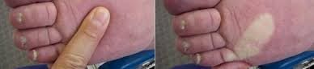
Sluggish Capillary Refill
Causes of sluggish or delayed cap refill: dehydration, shock, hypothermia
Capillary refill can also be prolonged in cold ambient temperatures or hypothermia.

Slide 48
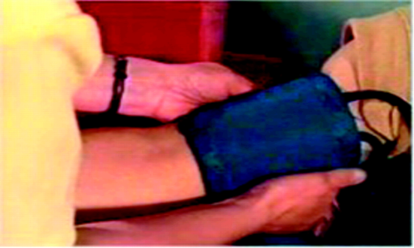
Blood Pressure
Cuff Size should cover 2/3 of
upper arm
Too big = low readings
Too small = high readings
Childhood hypertension is on the rise
Hypotension – very concerning
Children may remain normotensive until 25% of their blood volume is lost
Notes:
Blood Pressure Monitoring:
Ensure correct cuff size!
Too big= low readings
Too small=high readings
Correlation between the BP of parents and that of their offspring; Obese children have approximately a 3-fold higher risk for hypertension than nonobese children. As many as 41% of children with high BP have left ventricular hypertrophy.
Blood pressure is not a reliable predictor of shock in the paediatric patient as it is in the adult. Once a child’s BP has started to drop you have missed the boat!

Slide 49
Circulating Blood Volumes
Infants 90ml/kg
Child 80 ml/kg
Adolescent 70ml/kg
Small blood losses can cause circulatory compromise

Slide 50
Dehydration
Severe dehydration may be present without an alteration in Blood pressure. Other assessment clues such as Capillary refill, Peripheral perfusion, Heart rate, Respiratory rate, activity level, fontanelles, skin turgor, conc. urine must be used to assess potential for deterioration.
Infants cannot concentrate their urine.
Notes:
Signs are the same in patients of any age
Dry mucous membranes
↓ urine volume with ↑ urine concentration
Poor skin turgor
Sunken fontanels in the infant
Weight loss
Circulatory Compromise - ↓ cap refill

Slide 51
Fluid Resuscitation
Fluid bolus: 20 mL/kg
Newly born fluid challenge: 10 mL/kg
Fluid maintenance: consider 4:2:1 rule
4 mL/kg for patients up to 10 kg
2 mL/kg for every kg after 10 kg and under 20 kg
1 mL/kg for every kg over 20

Slide 52
Fluid Maintenance Example
Patient weighs 28 kg. What would be required
fluid maintenance?
4x10=40; + 2x10=20; +1x8=8
Total required: 68 mL/hr

Slide 53
Fluid Maintenance: DKA
Rapid fluid administration in children with DKA
is thought to be linked to risk of cerebral edema.
Fluids must be given much slower
(5-10 mL/kg/hr depending on level of dehydration)
Replace potassium as ordered
Monitor neuro status!!

Slide 54
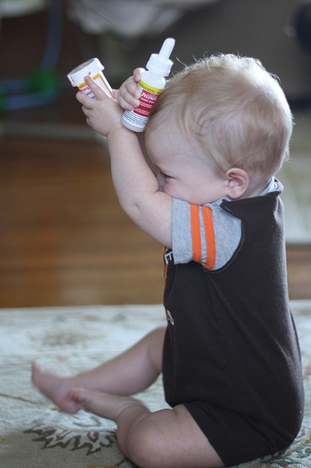
Antipyretics for Pediatrics
Acetaminophen 15mg/kg
Ibuprophen 10mg/kg

Slide 55

Fevers
Can cause seizures (6 months- 5 yrs.)
If on chemo, suspect sepsis. Antibiotics
required within one hour of arrival.
Diagnostics can include: CBC, ‘lytes, blood
& urine cultures, CXR, Lumbar puncture,
Notes:
95-98% of those with febrile seizures, will outgrow them and have no lasting effects. (National Institute of Neurological Disorders and Stroke, 2013)

Slide 56
Shock
Inadequate tissue perfusion of oxygen
Can result from:
Inadequate blood volume or oxygen-carrying
capacity
Inappropriate distribution of blood volume and
flow
Impaired cardiac contractility
Obstructed blood flow
Schwarz, 2013
Notes:
Types of shock:
Hypovolemic - Inadequate intravascular volume. - burns, DKA, trauma,hemorrhage, severe gastro,(nausea, vomiting and diarrhea)
Cardiogenic -Myocardial dysfunction, may be associated with hypovolemic or distributive shock.- V tach, V fib,myocarditis
Distributive -Inappropriate distribution of blood flow, characteristic of sepsis and anaphylaxis. (warm vs cold shock – early in clinical course one with distribute shock may present with dec. SVR and inc blood flow to skin -----warm shock; later course – dec cardiac output causes increased SVR and cold extremities, weaker pulses
Shock may be classified as Compensated or Uncompensated according to it’s effect on Blood Pressure.
Compensated shock - SBP in normal range
Uncompensated Shock- SBP < 5th percentile for age- hypotension
Hypovolemic shock is most common in children worldwide

Slide 57
Common Causes of Shock
Distributive
Sepsis
Anaphylaxis
Neurologic injury
Hypovolemic
Gastroenteritis
Hemorrhage
Trauma
Cardiogenic
Secondary to sepsis,
drugs
Heart disease
Obstructive
Congenital
Cardiac tamponade
PE
Tension pneumo
Schwarz, 2013

Slide 58
S & S Of Shock
Early Shock
Late Shock
Tachycardia
Normal BP
Sluggish cap refill
Peripheral cyanosis
Cool extremities
Diminished
peripheral pulses
COMPENSATED
Decreased LOC
No urine output
Mottled, cold skin
Ashen grey colour
Weak, thready or absent peripheral pulses
Hypotension
UNCOMPENSATED

Slide 59
Management of Shock Flowchart
Oxygen IV/IO Access Resuscitation as needed Pulse Oximetry ECG Monitor Glucose Check
AHA, 2011

Slide 60
Management of Shock: Hypovolemic
Non- hemorrhagic | Hemorrhagic
20 mL/kg/hr NS or LR, repeat as needed Consider colloid | Control external bleeding 20 mL/kg NS/LR bolus Transfuse RBCs prn
AHA, 2011

Slide 61
Management of Shock: Distributive
Septic | Anaphylactic | Neurogenic
Manage algorithm (In Resus Room) Monitor glucose levels closely. Antibiotics stat Fluids ++++(at least 60mL/kg in first hour) | IM epinephrine Fluid boluses Albuterol Antihistamines Corticosteroids Epinephrine infusion | 20 mL/kg NS/LR bolus, repeat prn Vasopressors (Epinephrine/ Norepinephrine)
AHA, 2011

Slide 62
Management of Shock: Cardiogenic
Brady/Tachy Arrhythmias | Other (e.g. Myocarditis, Cardiomyopathy, Poisoning)
Management Algorithms (In Resus Room) | 5-10 mL/kg NS/LR bolus, repeat prn Vasoactive infusion Consider expert consult
AHA, 2011

Slide 63
Management of Shock: Obstructive
Ductal dependent | Tension Pneumo | Cardiac Tamponade | Pulmonary Embolism
Prosta-glandin E Consult/transfer | Needle decom- pression Chest tube | Pericardio-centesis 20 mL/kg NS or LR | 20 mL/kg NS/LR bolus ? Thrombo-lytics/ anti-coagulants
AHA, 2011

Slide 64
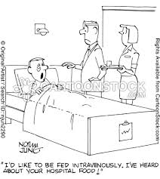
IV Access
Newborn: umbilical vein (catheter in Panda warmer)
Children: for catheter size, refer to Broselow tape
May need to consider IO access
Always use pump

Slide 65
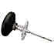
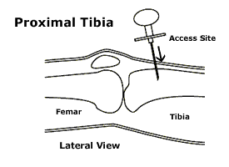
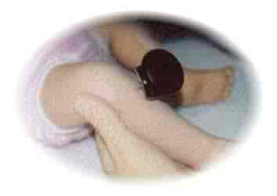
Intraosseous Needle
For emergency access
May be used for IV fluids and/or medications
Absence of bone marrow aspirate does not indicate misplacement

Slide 66
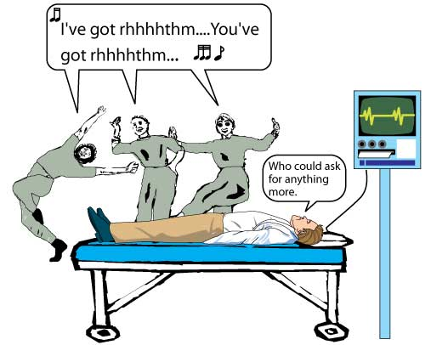
Cardiac Arrhythmias
SVT
Sinus tachycardia
Bradycardia
Notes:
Persistent bradycardia is most commonly produced by:
hypoxemia,
tissue hypoxia,
severe hypotension or
acidosis
Transient bradycardia may be normal in the infant or child particularly during periods of sleep or times of vagal stimulation

Slide 67
Tachycardia
Sinus Tachycardia
HR <220 infants; HR < 180 children
Rate varies with activity/ stimulation
P waves visible
Gradual onset
History and exam consistent with volume
loss, (blood, V&D, fever)
Notes:
Sinus tachy: usually physiological
SVT: vagal maneuvers, adenosine

Slide 68
Tachycardia
SVT
HR > 220 infants; HR > 180 children
No beat to beat variability …
P waves indiscernible
Abrupt onset
History non specific,
S&S of poor perfusion, decreased peripheral pulses , prolonged cap refill,

Slide 69
Bradycardia
Ominous rhythm in children
Start compressions if HR<60
Often related to hypoxia
Follow PALS/NRP algorithm
in resus. room
Notes:
A child – any time before puberty (age 8ish)

Slide 70

Neurological Assessment
of the pediatric patient

Slide 71
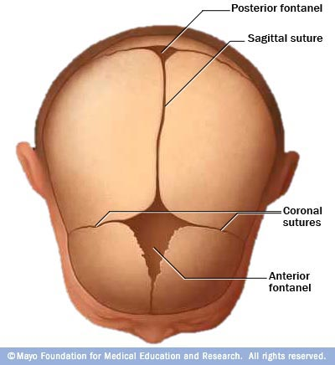
“D” Disability and Neuro
Large head to body ratio
Anterior fontanels
closes 18-24 mos.
Posterior fontanels
closes ~6 weeks
Primitive reflexes
Notes:
The head is proportionally larger in regard to both body surface area and weight. Neck musculature is relatively weak. The head is more likely to sustain impact injuries. This places the paediatric patient at risk for head injury.
At birth the brain is 25% of its mature weight, by 2 ½ yrs. the brain has achieved 75% of its mature adult weight.
The Central Nervous System has a limited ability for regeneration. Children, though, tend to have better outcomes than adults following severe head injury, although the exact reason for this difference is unclear.
Moro Reflex- until 6 mos.- the startle reflex Infant will open hands, extend and abduct upper extremities and then flex as in an embrace.
Palmar Reflex - until 6-7mos- placing a finger in the infants palm will result in the infant grasping the finger.
Babinski Reflex- until about 2 years - Stroking the sole of the infants foot from the heel to the toes will elicit fanning of the toes and flexion of the great toe.

Slide 72
Neurological Scales
AVPU
GCS- Paediatric
Consider developmental age
Finger pick when indicated

Slide 73
Altered LOC
Poor muscle tone
Decreased responsiveness
Incontinence
Inability to protect airway
Altered respiratory status
Altered heart rate
Hypothermia, hyperthermia
Treatment: A..B...C.. then D

Slide 74
Treatment
A- ensure airway patency
B – ensure adequate ventilation/oxygenation
by assessing patient
C- ensure adequate perfusion by assessing pt.
D- depending on presentation; monitor glucose
E – assess pt.; consider cervical spine protection

Slide 75
Neurological Presentations
Concussions
Headache
Seizures
Meningitis
Hydrocephalus
Head injuries
Notes:
Concussions: new data on repetitive head injuries
instruction sheet
gradual return to previous activities as directed by physician
Seizures: febrile seizures up to age 4
Hydrocephalus: ongoing risk of inc. ICP, many have VP shunts, regular neuro checks is key

Slide 76
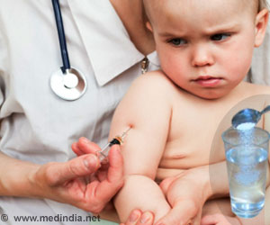
Pain Assessment
of the pediatric patient

Slide 77
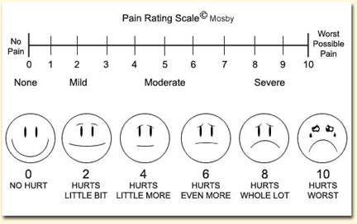
Pain Scales

Slide 78
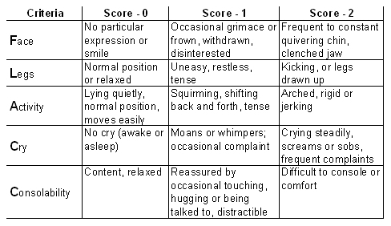
FLACC Scale

Slide 79
Physiological Signs of Pain
Tachycardia
Pallor
Diaphoresis
Restlessness
Response can be affected by
previous experiences

Slide 80
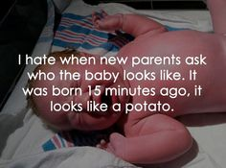
Neonates/Infants
Emergency Assessment

Slide 81
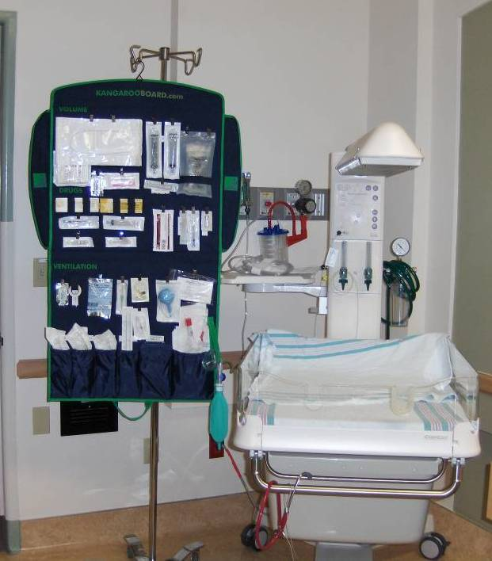
Neonates or Pediatrics?
Babies from 0-30 days
are neonates
Consider using Panda
Kangaroo Board
Kept with Panda warmer
Complete daily checklist

Slide 82
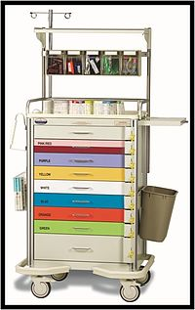
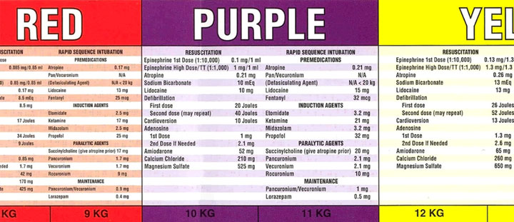
Neonates or Pediatrics?
For babies older than 30 days use Broselow for equipment

Slide 83
Newborn Deliveries
Consider: Is baby term?
Is baby breathing/crying?
Does baby have tone?
If no, gently stimulate;
Dry baby;
Provide warmth; clear
Airway; monitor breathing
& HR
If yes, give to mom
Let baby get dry;
Provide warmth
skin on skin
American Heart Association, 2010

Slide 84
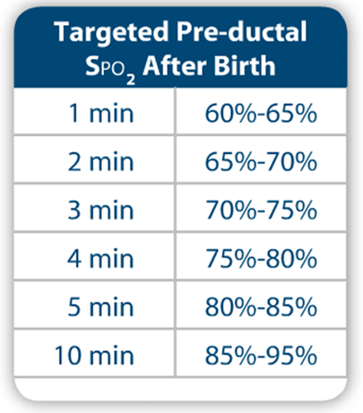
Newborns: Oxygen Requirements
Place oxygen probe on R hand.
Pre-ductal SpO2 reflects the
oxygenation of the blood coming
from the lungs
Avoid hyper-oxygenation

Slide 85
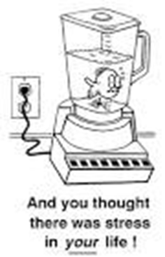
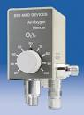
Oxygen Blender
Used in ventilation of newborns to prevent oxygen toxicity
With a blender one can achieve a controlled oxygen-air mix to achieve target SpO2 levels. The blender has a control knob to dial in the desired oxygen concentration, from 21-100% oxygen.

Slide 86
Infants
.
Regain birth wt. by 10 days
Double in 4-6mos
Triple by one year
Normal FT gestation 37- 40 wks.

Slide 87
Infants
Neonate 0-28 days (corrected age)
Infant 28 days – 12mos
Newborns normal posture is one of flexion, with good muscle tone
90ml/kg circulating blood volume

Slide 88
Thermoregulation
Large surface area/volume ratio
Immature response system
Lose more heat to the environment
May lose heat through IV fluid administration
Have thin skin with blood vessels near the
surface provides poor insulation, leading to
further heat loss
Core temp. does not drop until infant has lost
ability to produce heat
Hartley, 2008
Notes:
There are four mechanisms by which heat is lost 1) conduction, 2) convection, 3) radiation, and 4) evaporation. Conduction is the transfer of heat from one object to another by direct contact.
Convection occurs as heat is transferred from an object to the surrounding air
Radiation is the transfer of heat between two objects that are not in direct contact with each other.
Evaporation losses occur as moisture from body surfaces is lost to the environment.

Slide 89

Cold Stress
Inc. O2 consumption
Inc. glucose use
Peripheral vasoconstriction
Inc. BP and HR
Acid production Acidosis
Arrhythmias
Grandma was right… put a hat on that baby!
Hartley, 2008
Notes:
When brown fats are metabolized in the presence of insufficient oxygen supply increased acid production will result. Rising amount of acids causes metabolic acidosis. Brown fat is great source of energy in neonate

Slide 90
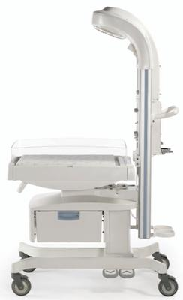
Panda Warmers
Heat source
Rails that
can be lowered
Temperature probe
jack
Equipment for
newborn resuscitation
on Kangaroo board
Notes:
An infant who has a body temperature greater than 37– 37.5ºC may be considered abnormally warm

Slide 91
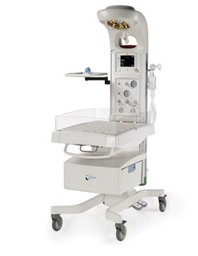
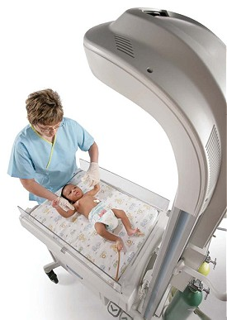
Panda Warmers
off/on button
Timer
for resuscitations;
apgar scoring
Position of Baby in Panda

Slide 92
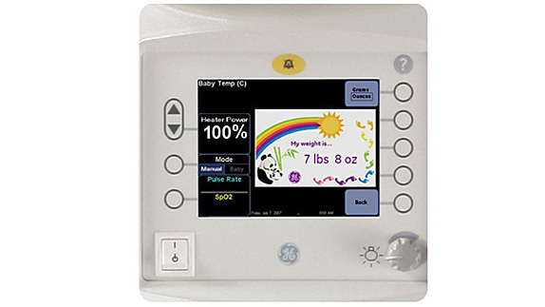
Apgar
Menu
Scale
Off/on

Slide 93
Neonatal Sepsis
Subtle signs
The pathophysiology of sepsis is the same,
but the onset is more rapid and severe.
Systemic infections can progress rapidly to septic shock.
Infants are reliant on maternal antibodies for
protection from infection.

Slide 94
Signs & Symptoms
Crying, sleeping, poor feeding, vomiting, diarrhea
Fever, temperature instability
Respiratory distress, tachypnea, apnea
Central cyanosis, pallor, mottled extremities
Tachycardia, cap. refill …. Bradycardia
LOC, flaccid, limp, weak reflexes, poor muscle tone, seizure
Notes:
Neonates cannot always mount a febrile response – cannot rely on temperature as sole indicator

Slide 95
Treatment
Oxygen
Full septic blood panel
IV fluid resuscitation – up to 60mL/kg
Antibiotics stat when ordered
Close monitoring

Slide 96
Sudden Infant Death Syndrome
Peek occurrence 2-4 mos.
No exact causes..
“Back To Sleep” Campaign
Avoid smoking around infant
Firm, flat mattress
Avoid overheating
no bumper pads, waterbeds, pillows
Continue breastfeeding
Notes:
but 50% reduction in countries following the “Back To Sleep” campaigns
The mechanism of sudden death in the prone position may be an Increased Resistance to airflow, obstruction from displacement of the mandible compression of nose in soft bedding or compromised blood supply to brain stem

Slide 97
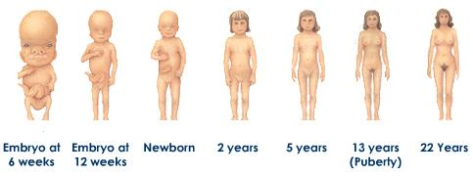
Growth & Development
Considerations in the ED

Slide 98
Growth & Development
Neonate: birth to one month
Infant: 1- 12 months
Toddler: 12-36 months
Pre-school: 3-5 years
School-age; 6-10 years
Pre-adolescence: 10-13 years
Adolescence: 13-19 years

Slide 99
Special Population
Consider the intellectually disabled
Those technically dependent may have
additional needs (i.e. social, emotional)
The chronically ill may have regressed or
be advanced socially. They may wish to have
more control. Consider giving them choices,
when appropriate.

Slide 100
Transport Team
Charge Nurse to page Charge Nurse of NICU or PCCU
Physician to Physician discussion
Neonatal Pediatrics
For Age <28 days For age >28 days
Choose Neonatal Choose PICU

Slide 101
(Respiratory sounds)
RESPIRATORY DISTRESS SYNDROME (RDS)
http://www.youtube.com/watch?v=nr0BH_4jylk&feature=player_detailpage
http://www.youtube.com/watch?v=Jc8w2USNZ3A
http://www.youtube.com/watch?v=Hv68EQ3tCBI
http://www.youtube.com/watch?feature=player_detailpage&v=q0bHwMayCJY
CROUP:
http://www.youtube.com/watch?feature=player_detailpage&v=1Enq2BvX9aw
http://www.youtube.com/watch?v=Qbn1Zw5CTbA&feature=player_detailpage
PERTUSSIS (WHOOPING COUGH):
http://www.youtube.com/watch?v=TIV460AQUWk&feature=player_detailpage
http://www.youtube.com/watch?feature=player_detailpage&v=wuvn-vp5InE&list=PLKe1ajRQjBf0i8Qu49H7uRmchroFYXvih
ASTHMA:
http://www.youtube.com/watch?v=OxDj_QaTk44&feature=player_detailpage

Slide 102
Reference
American Heart Association (2010). Newborn Resuscitation Algorithm.
American Heart Association (2011). Pediatric Advanced Life Support.
Hartley, P. (2008). Neonatal Thermoregulation. Retrieved January 2, 2014 from
http://www.ceufast.com/courses/viewcourse.asp?id=63#Temperature_Assessment
Padlipsky, P. & Gausche-Hill, M. (2008). Respiratory Distress and Respiratory
Failure. In Pediatric Emergency Medicine (ed. Rothrock & Brennan).
Pennsylvania: Elsevier Saunders
Schwarz, A. J. (2013). Shock in Pediatrics. Medscape. Retrieved Dec. 19, 2013
from http://emedicine.medscape.com/article/1833578-overview#aw2aab6b2b3
Steinmann, M. (2014). Personal Communication

